Slide 1
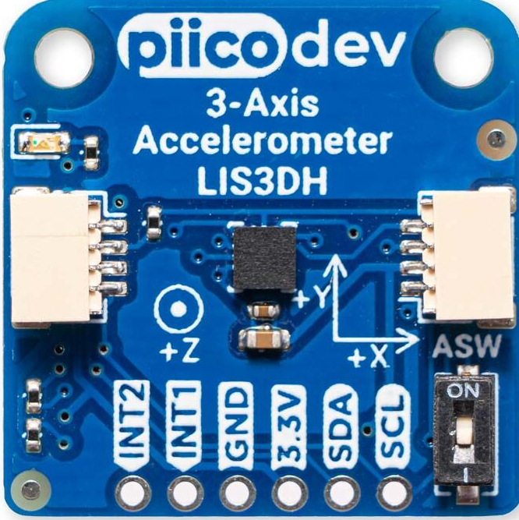
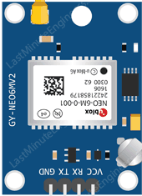
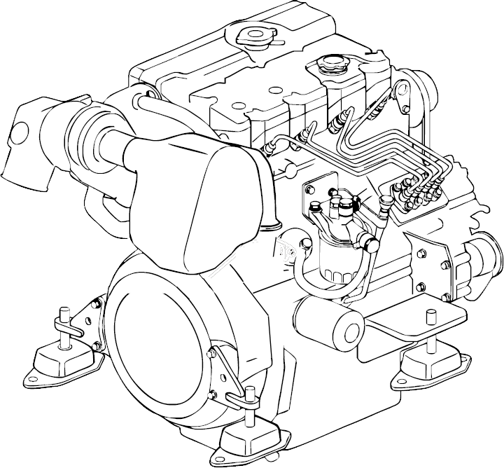
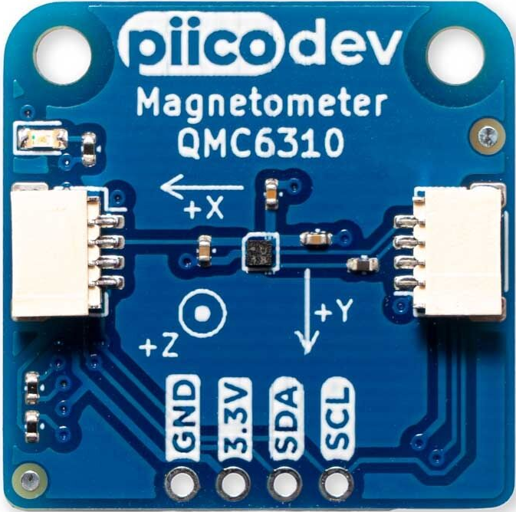
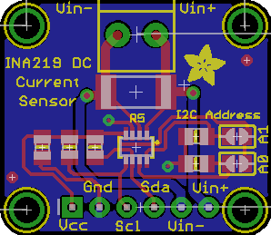

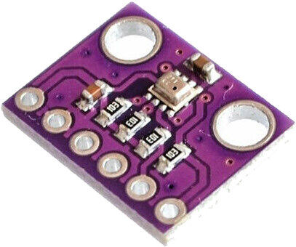
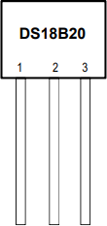
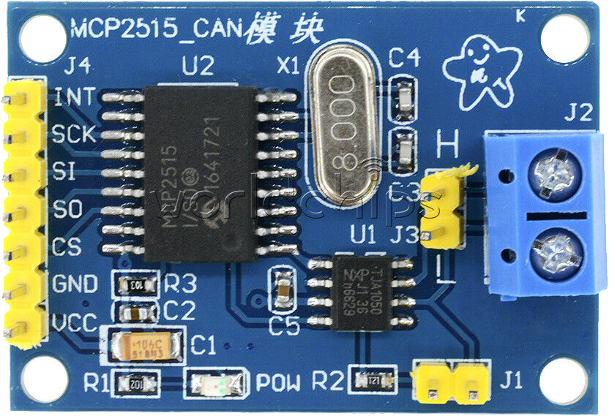
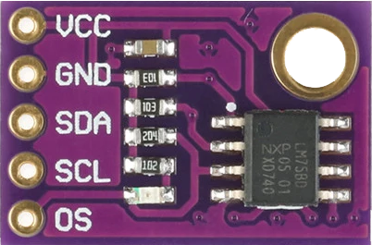
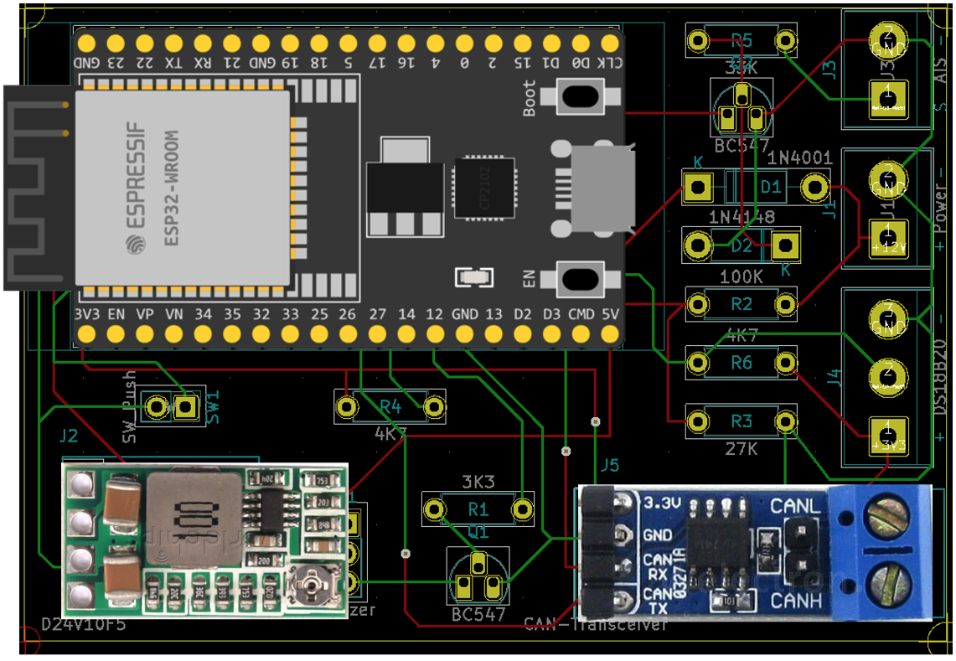
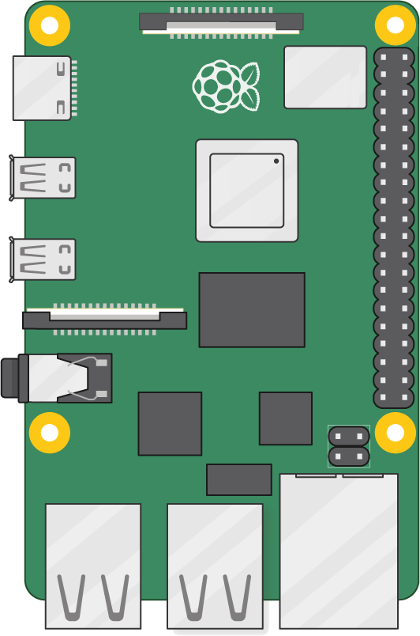
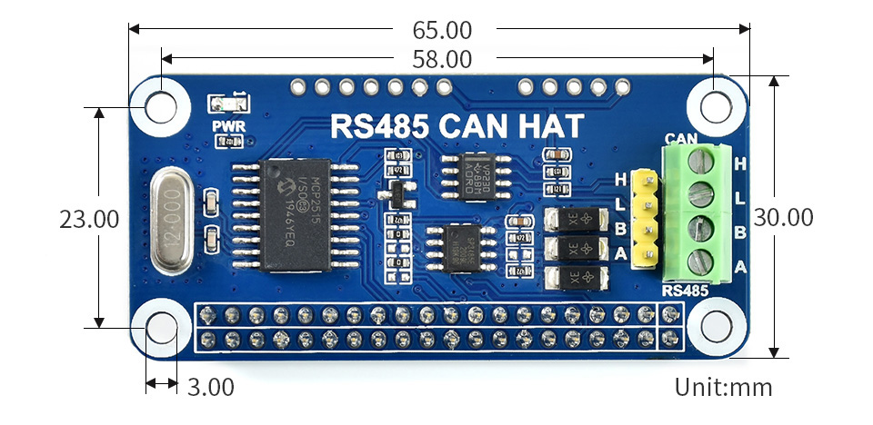
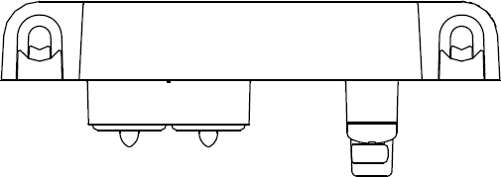
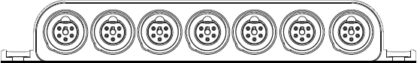

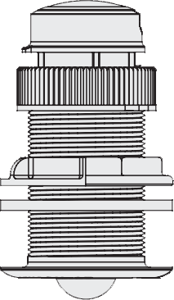
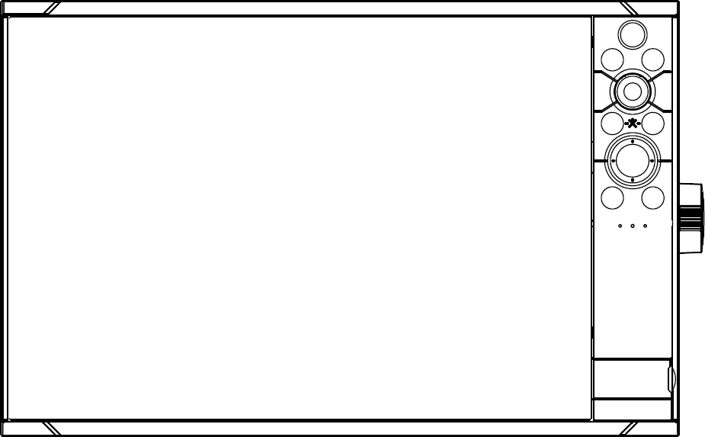
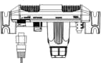
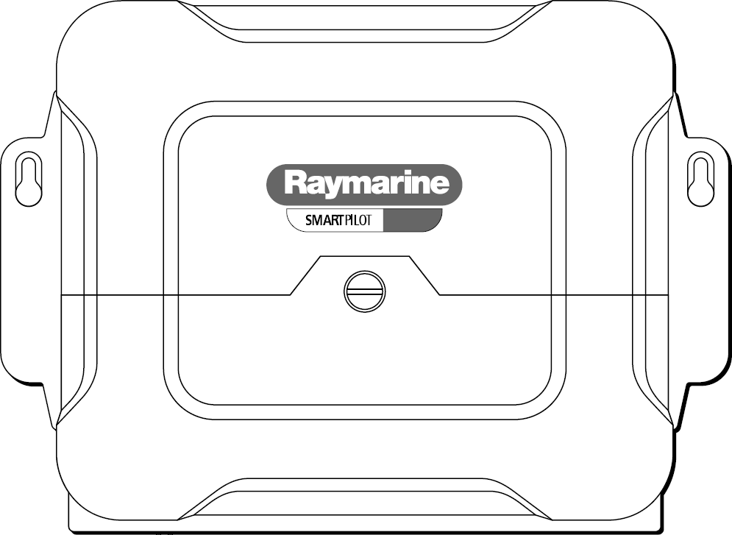
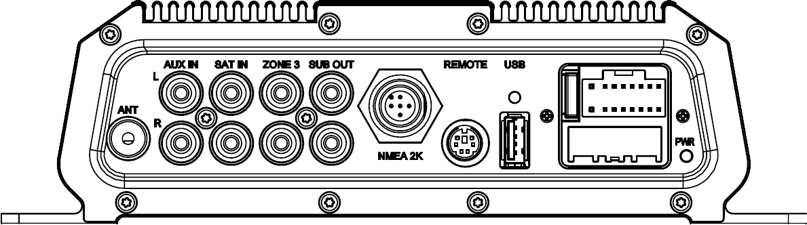
House
Controller
GPS
Engine Room
Controller
VolvoPenta D2-50
Attitude
Alternator Sense
Heading
Battery
SignalK Server
Exhaust
Atmosphere
RS232
Alternator
Battery
I2C
PWM
CANBus
N2K Power
Freezer
N2K
(+POWER)
Fridge
N2K
(Termination)
1-Wire
N2K (Termination)
AT10 Converter
FREE
N2K Backbone
N2K Backbone
GPS Antenna
FREE
Network
DST800 Triducer
NSS EVO3
4G Radar
Sonic Hub
Autopilot

Slide 3

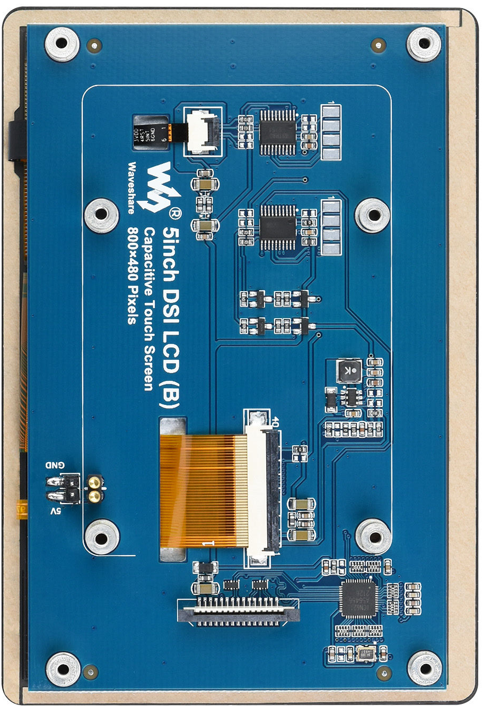
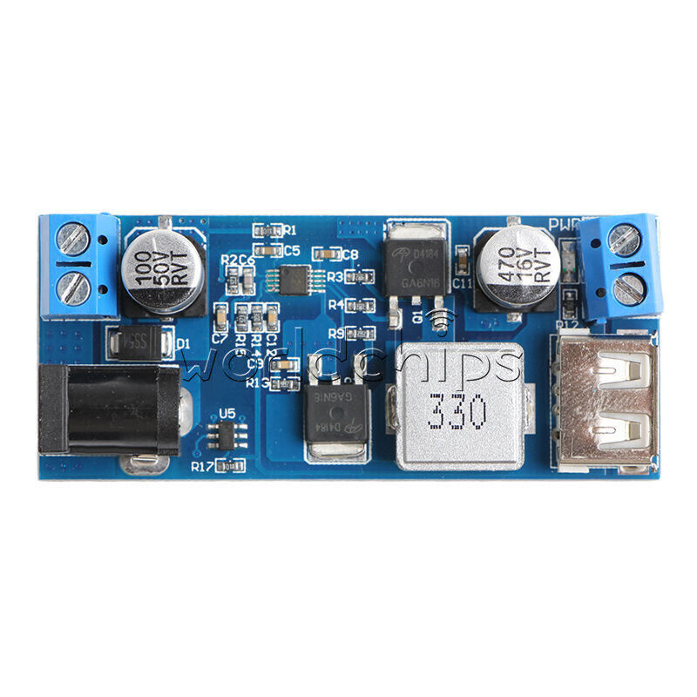
Network

Slide 4
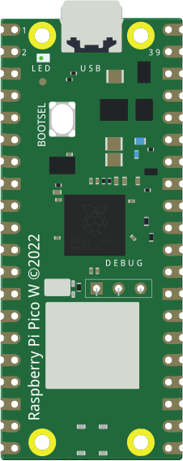
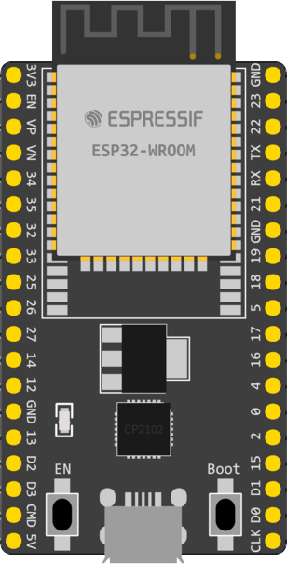
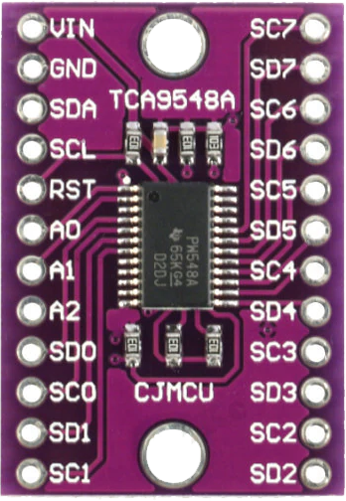
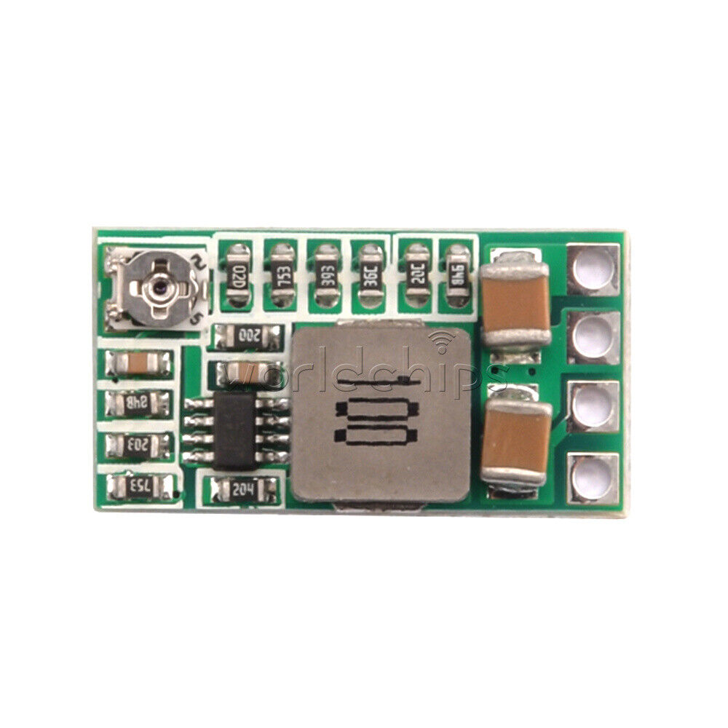
Multiplexer

Slide 5
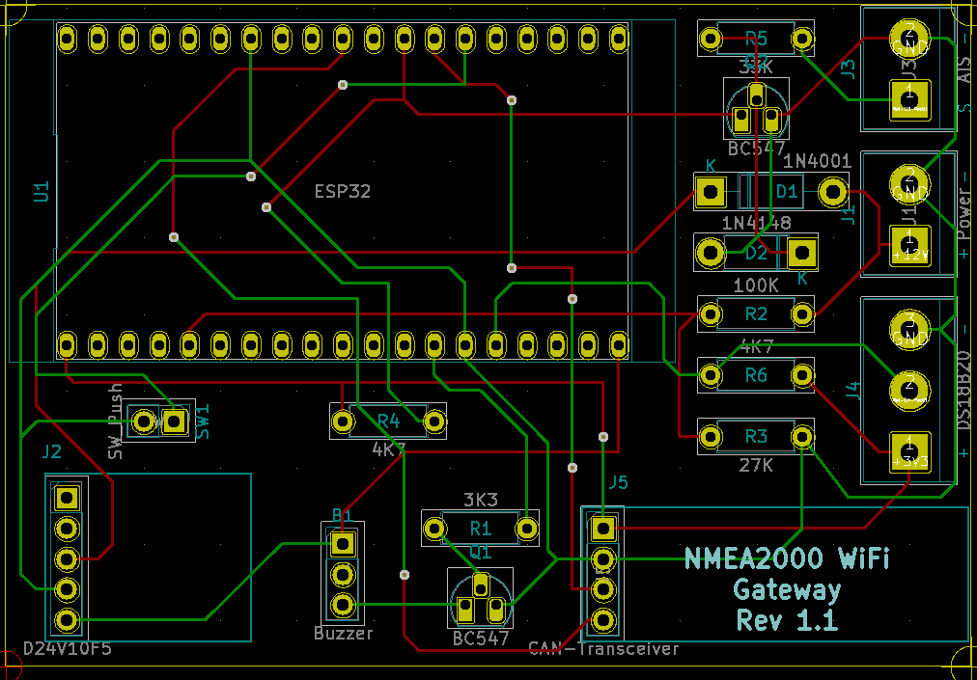
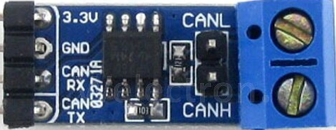

Slide 6
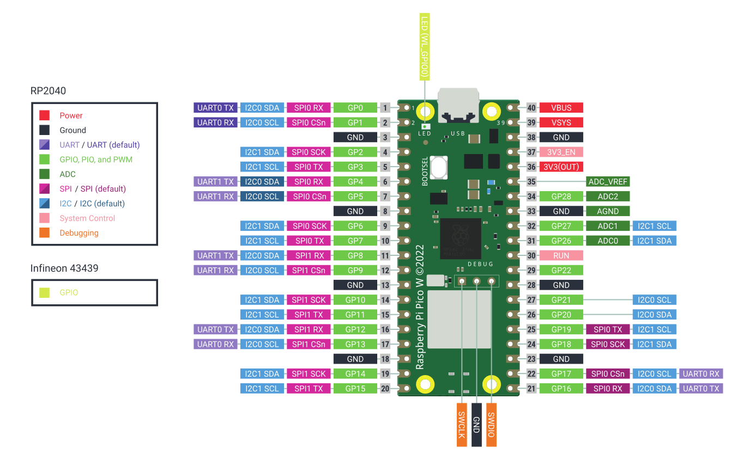

Slide 7
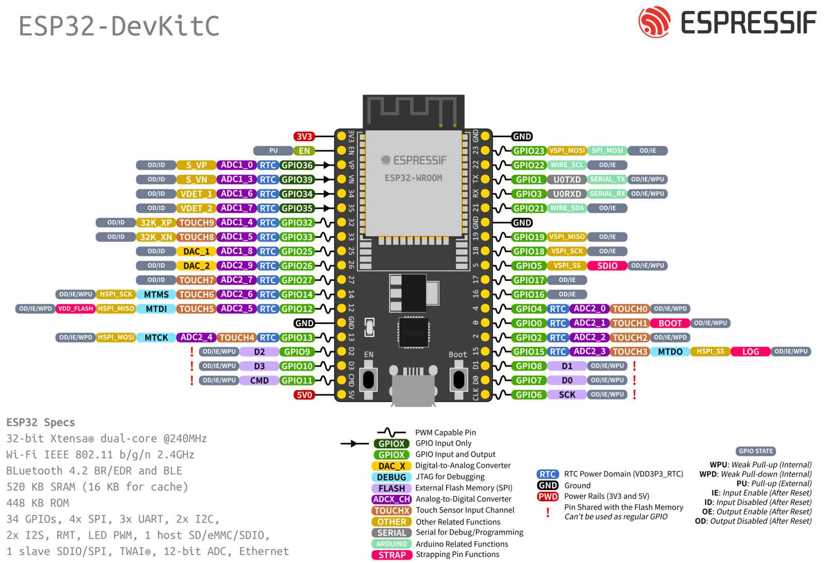

Slide 8


Slide 9
LCD Controller Diagram
LCD Display Unit
VSS VDD VO
RS R/W E
DB0 - DB7
VDD
A
K
1 2 3 4 5 6 7 8 9 10 11 12 13 14 15 16
Vcc
Vcc
9
10 Pin IDC
ICSP Connector
Vcc
5k
7
PIC16F628A
Microcontroller
5
A4
B6
B3
A0-A3
3
1B1A76A
IR Receiver
B7
Vcc
1
MCLR
10k
B0
5k
15pF
OSC1
Vcc
4MHz
Xtal
OSC2
VDD
Vcc
15pF
B1
B2
VSS
B4
B5
CTS
RTS
TX
RX
8
7
5
2
3
RX
RX
GND
RD
TD
DB9 Serial Connector
For Serial I/O Using PIC16F628A
Notes:
I/O requirements:
LCD data lines: 4 x output lines
LCD Control Enable and Register Select
I/R in 1x Input pin
I2c Interface for EEPROM
For Serial I/O Tx and Rx
For USB +D, -D and Vusb or 8-bit data bus and control lines

Slide 10
LCD Controller Diagram
LCD Display Unit
RS
E
DB0 - DB7
A
K
1 2 3 4 5 6 7 8 9 10 11 12 13 14 15 16
Vcc
Vcc
9
10 Pin IDC
ICSP Connector
7
PIC16C645
USB Microcontroller
5
A5
B3
A0-A3
3
1B1A76A
IR Receiver
Vcc
1
MCLR
10k
B0
10nF
Vusb
OSC1
24LC16B
I²C Serial Eeprom
Vcc
OSC2
A0
SCL
A1
SDA
Vcc
Vss
D-
D+
Vcc
Vcc
Vcc
USB B Connector
For USB I/O Using PIC16C645
Notes:
I/O requirements:
LCD data lines: 4 x output lines
LCD Control Enable and Register Select
I/R in 1x Input pin
I2c Interface for EEPROM
For Serial I/O Tx and Rx
For USB +D, -D and Vusb or 8-bit data bus and control lines

Slide 11
Device Firmware Flowchart
InitMCU
CTS = Space
Wait 100mS
Read DeviceID from EPROM
Read LCDChars from EPROM
Read LCDLines from EPROM
Read LCDMode from EPROM
Read LCDFont from EPROM
LCDOUT $FE, 1 ‘ clear display
LCDOUT “Device ID: “, #DeviceID ‘ display DeviceID
Wait 1000mS
LCDOUT $FE, 1 ‘ clear display
EstComms
Tx DeviceID, LCDChars, LCDLines, LCDMode, LCDFont
CTS = Mark
Rx HandShake
CTS = Space
IF NOT HandShake THEN 1.
SndDisplay “Success”
Wait 1000mS
ChkSerIn
CTS = Mark
Rx StrData
CTS = Space
IF NOT DeviceID Then ChkIR
IF Setup THEN Setup
IF Data THEN SndDisplay
ChkIR
Check IR Receiver
IF IR TRUE GOSUB CmdIR
Notes:
DeviceID = IDnnnnn CR LF
DisplayFormat = DFnnnxnn CRLF
HostHandShake = DeviceID CRLF

Slide 12
Device Firmware Flowchart: InitMCU
During Programming save data to EPROM:
DeviceID (Word) =
CharactersLCD (byte)
LinesLCD (byte)
ModeLCD (byte)
FontLCD (byte)
Declare Variables:
DeviceID(Word)
LCDChars(byte)
LCDLines(byte)
LCDMode(byte)
LCDFont(byte)
InitMCU
Wait 100mS
READ DeviceID from EPROM
READ LCDChars from EPROM
READ LCDLines from EPROM
READ LCDMode from EPROM
READ LCDFont from EPROM
LCDOUT $FE, 1 ‘ clear display
LCDOUT “Device ID: “, #DeviceID ‘ display DeviceID
LCDOUT $FE, $C0, “Mode: “, LCDCHars, “ x ”, LCDLines
Wait 1000mS
LCDOUT $FE, 1 ‘ clear display
Notes:
DeviceID = IDnnnnn CR LF
DisplayFormat = DFnnnxnn CRLF
HostHandShake = DeviceID CRLF

Slide 13
1. Block Diagram
Notes:
DeviceID = IDnnnnn CR LF
DisplayFormat = DFnnnxnn CRLF
HostHandShake = DeviceID CRLF

Slide 14
LCD Driver Flowchart
Start
Dimension Variables
Set Ports
for
Input and Output
Initialize and
Clear Display
LCDINIT:
Check Pin 6
for Data
CHKINPUT:
Data Received?
No
Send Character to
Ser-Parallel
SERSEND:
Write Character to
LCD Module
LCDWRT:

